Slide 1
Planning Your Future
Senior Class Presentation

Slide 2
Your School Counselors
Ms. Herskowitz
Last Names A-F
Ms. Bereskin
Last Names G-O
Mr. Turner
Last Names P-Z

Slide 3
Graduation Requirements
English 4 - CREDITS
Math (must include Algebra 2) 4 - CREDITS
Science 3- CREDITS
Social Studies 3- CREDITS
World Language 2 - CREDITS
Health .5 - CREDIT
P.E. 1 - CREDIT
Career Pathway 3 - CREDITS
Electives 3.5 - CREDITS
TOTAL 24 CREDITS

Slide 4
It’s Time to Start Thinking About Life After MPHS…….
College- 4 or 2 year
Trade School
Military
Employment
There is no right or wrong answer as long as you have a plan!

Slide 5
How to Apply for College/Trade School
College/Trade School website
Common Application
Black College Common Application
Paper Application
If you receive free/reduced priced lunch, ask your counselor about application fee waivers
There are some forms that will need to be completed by your counselor or recommenders!

Slide 6
Academic Common Market
Pay in-state tuition at an out-of-state school if a Delaware State School does not have your major!
Visit www.sreb.org to view the specific programs/schools that participate.

Slide 7
ACT/SAT
If you haven’t already taken either test and are planning to you should sign up ASAP.
You must have a CollegeBoard account to sign up.
SAT’s- October 1st, November 5th, December 3rd
ACT’S- October 22nd and December 10th
If you receive free/reduced priced lunches, your counselor can give you up to two fee waivers.

Slide 8
Request Your Official Transcript
Colleges/Trade Schools will want to have your official transcript sent from the guidance office.
A transcript request form must be completed for each application and given to your counselor (these forms can be found on the MPHS website under the Guidance tab and in the guidance office)
Six transcripts are sent free of charge
A fee of $2.00 will be charged for each transcript over six! If it is not paid, it will be an obligation!!!!
Please request your transcript no later than 2 weeks before the application deadline!

Slide 9
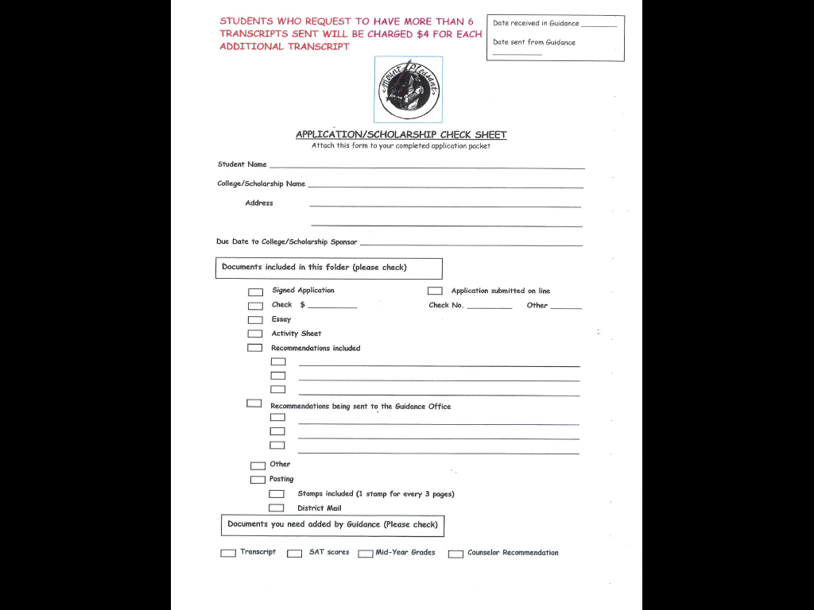

Slide 10
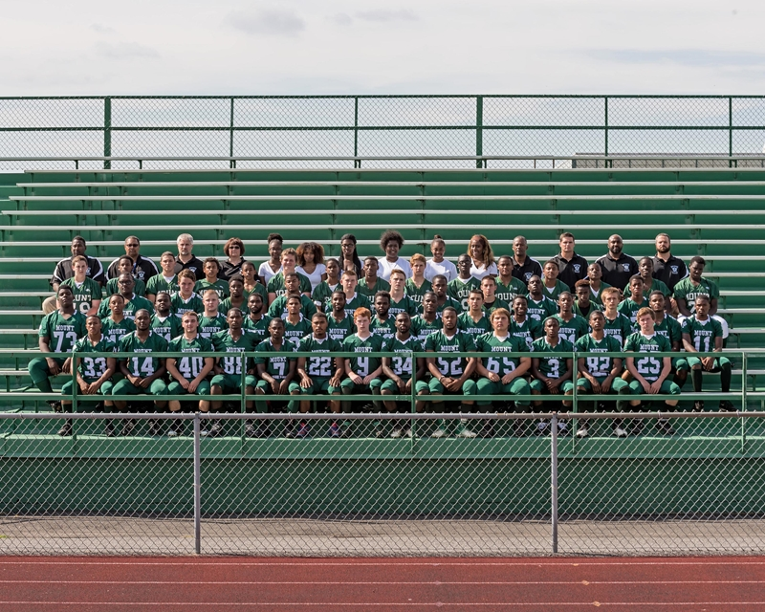
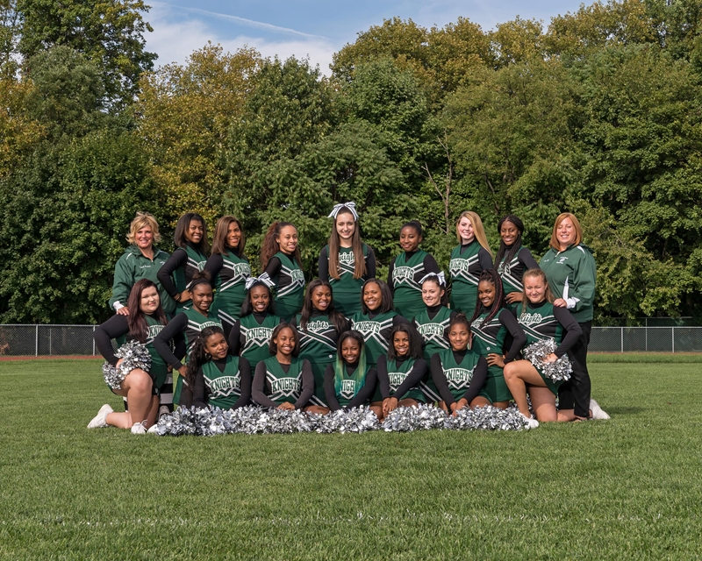
Activity Sheet/Resume
This can be a good way to show your special qualities to the admissions counselor.
Quality vs. Quantity

Slide 11
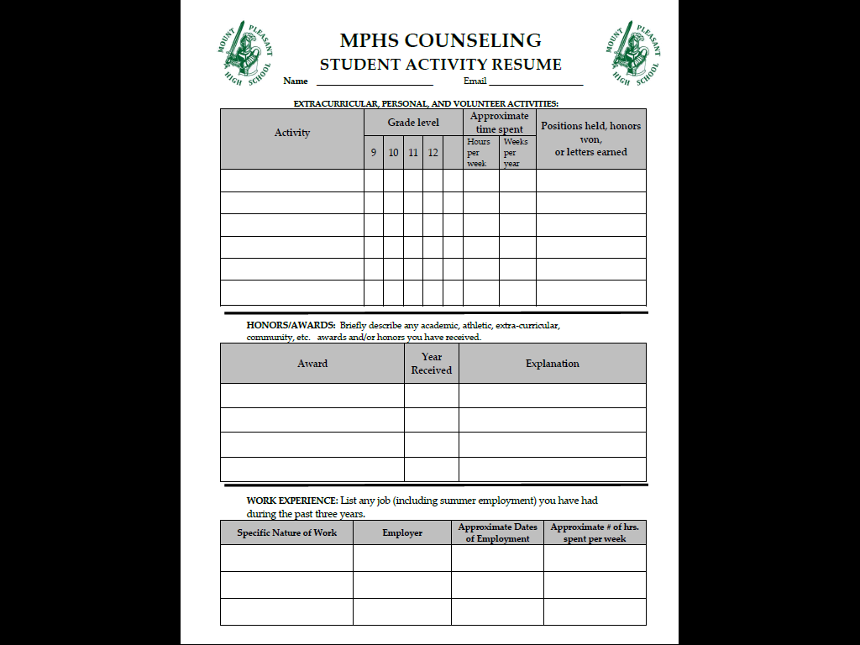

Slide 12
Recommendations
When to ask? ASAP!
Teachers who can describe your abilities
Counselor
Coaches
Club Advisors
Employer
Don’t forget to thank your recommender!

Slide 13
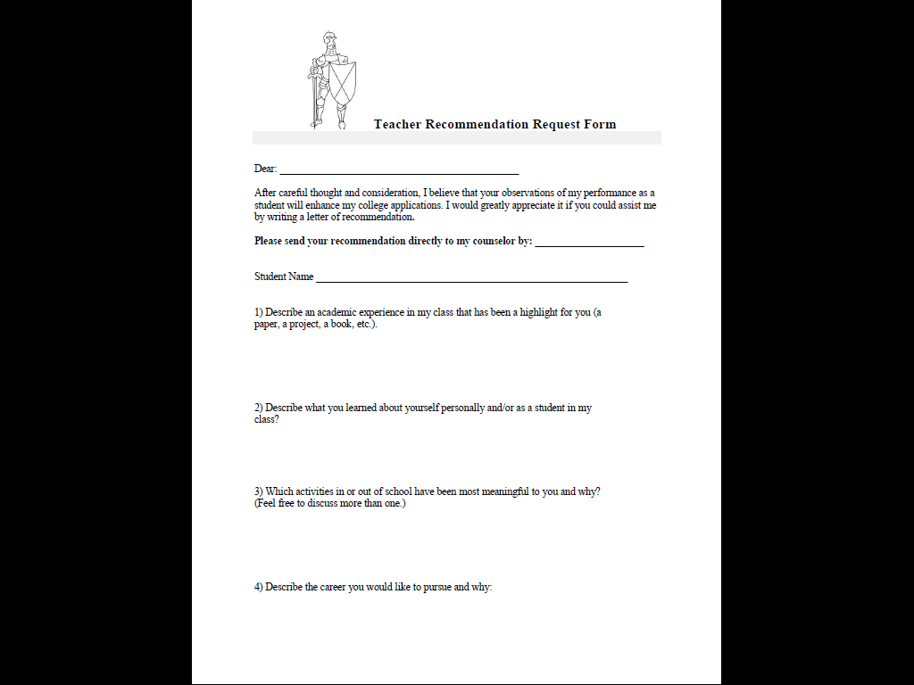

Slide 14
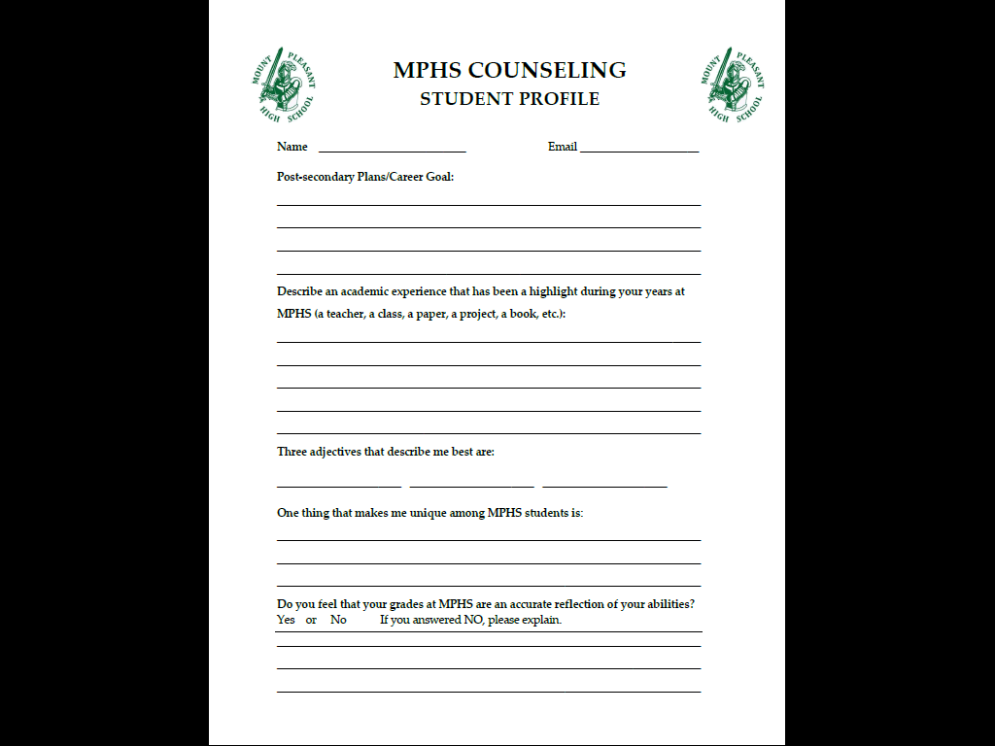

Slide 15
Deadlines are Important!
Please keep track of your application deadlines!
Early Decision
Early Action/Priority Deadline
Rolling Deadline

Slide 16
College Athletics
NCAA Eligibility Center
Know the rules for each Division
See Mr. Turner for a fee waiver, if you receive free/reduced priced lunch.

Slide 17
Paying For College
FAFSA (Free Application for Federal Student Aid)
This online form must be completed in order for you to qualify for financial aid.
Complete it online at www.fafsa.ed.gov after Don’t use any other website!!
FAFSA Presentation: September 27th at 7pm in the Auditorium
FAFSA Completion Workshop: October 20th at 7pm in room 212

Slide 18
SEED Scholarship
Two years free tuition at Del Tech Community College or in the University of Delaware’s Associate of Arts Program
2.5 Cumulative GPA required
No felony convictions
Application is not needed for UD, but is for Del Tech (usually available in early January)

Slide 19
MPHS College Application Week
We will have computer labs available for you to use during the day with adult volunteers to help you fill out applications!
Be on the look out for letters from the guidance office that will be coming to your house, listen for announcements, and be sure to participate!

Slide 20
